Slide 1


University Admission System
7/1/2018
Notes:
Copyright © 2011 IGATE Corporation (a part of Capegemini Group). All rights reserved.
No part of this publication shall be reproduced in any way, including but not limited to photocopy, photographic, magnetic, or other record, without the prior written permission of IGATE Corporation (a part of Capegemini Group).
IGATE Corporation (a part of Capegemini Group) considers information included in this document to be confidential and proprietary.

Slide 2

Team Members
Nanaiah Bopanna( Team Leader)
Shivangi Verma
Nagasri Durga Sravani Kancharla
Ameena Baratam
Abhishek Thakur
Nishtha Paliwal

Slide 3
Project Overview
This project is aimed at developing an University Admission System(UAS), for a university, which is used by :-
Applicants to apply for a course
Member of Admission Committee(MAC) for accepting Applicants into the university
Administrator to perform administrative activities which includes managing programs, generating reports and viewing applicant list.

Slide 4
Project Overview
Applicants can apply for a program by filling the registration form without any login process.
Members of Admission Committee(MAC) alone will be able to view applications, approve or reject the application for a specific program and confirm applicants after providing interview date.
Only the administrator has the right to keep track of the program details and manage programs.

Slide 5
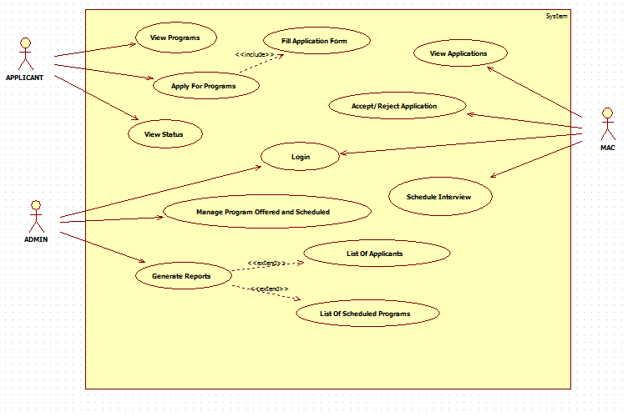
Use Case Diagram

Slide 6
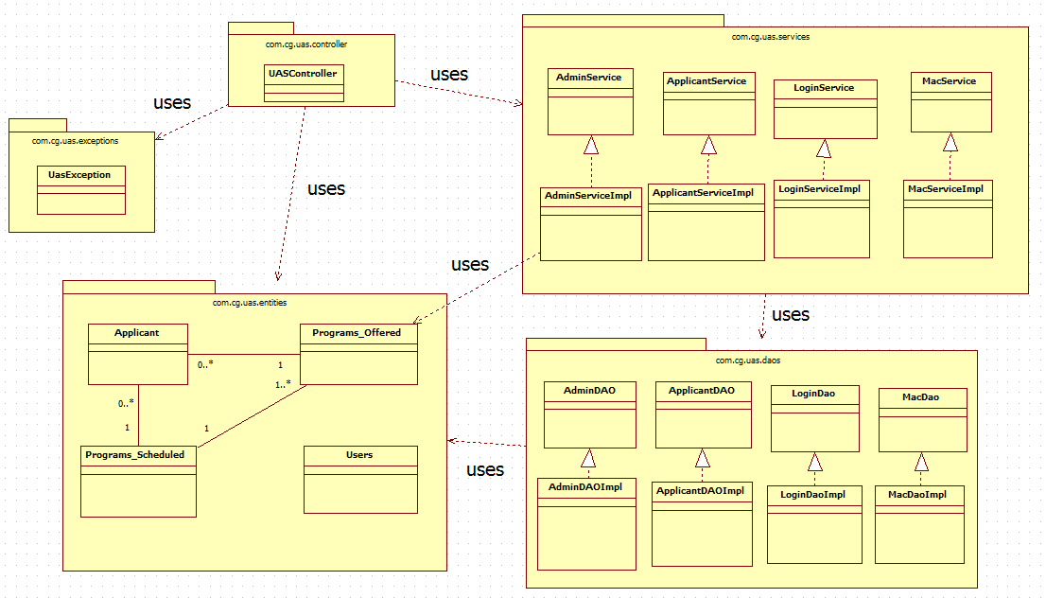
Class Relationship Diagram

Slide 7
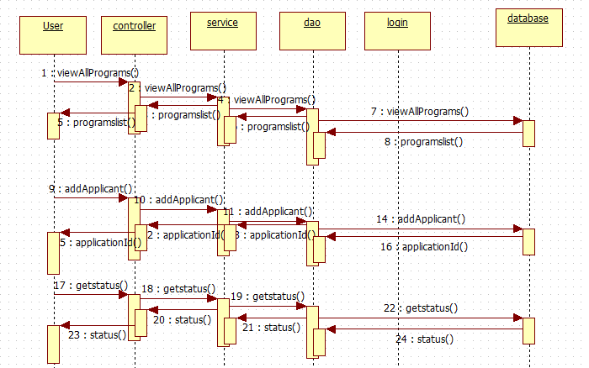

Sequence Diagram

Slide 8
Home page

Slide 9
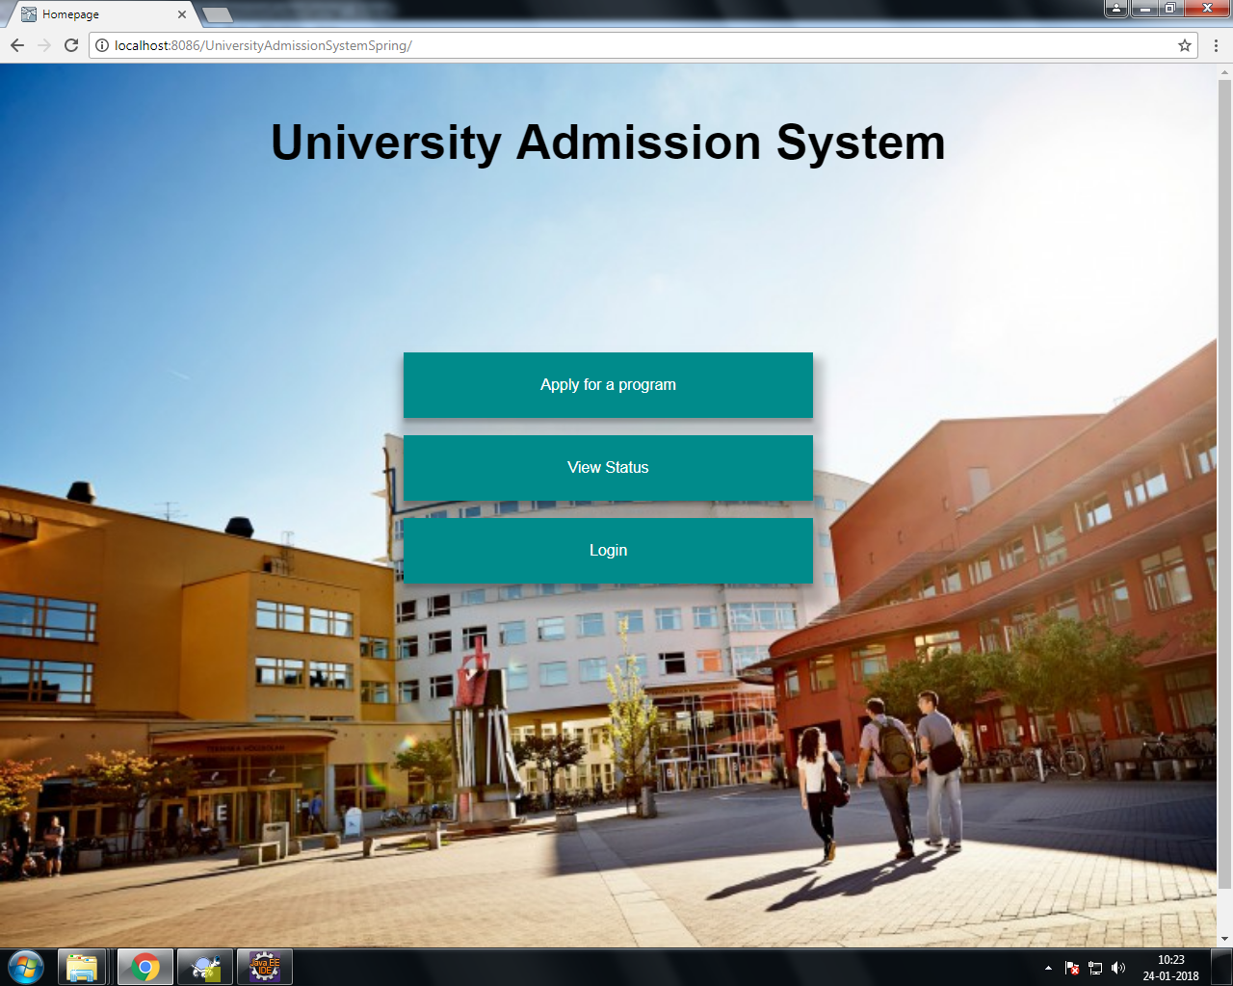
Home Page

Slide 10
Applicant Module

Slide 11
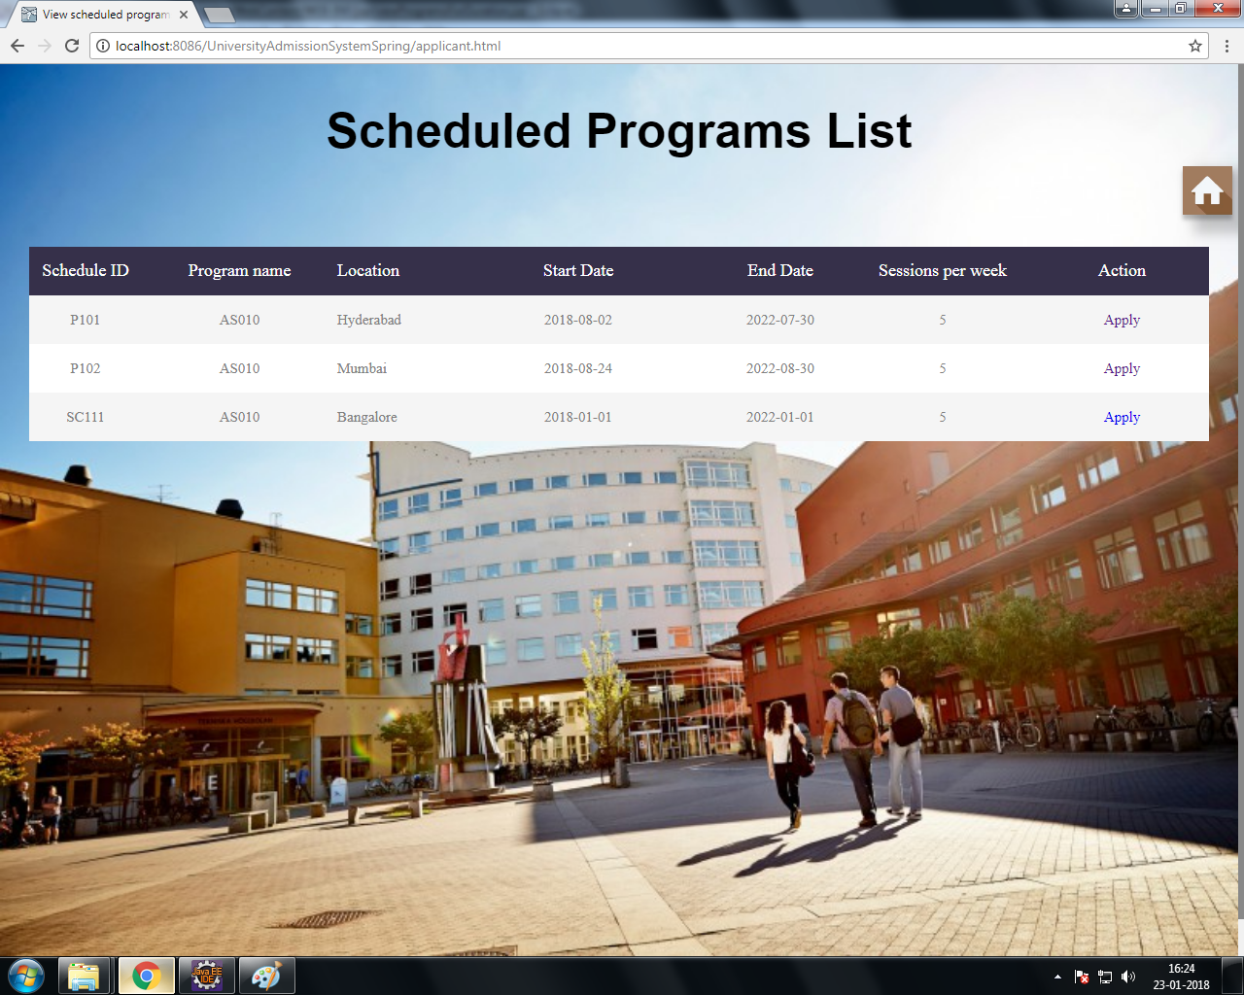
View programs
View all programs scheduled by the university

Slide 12
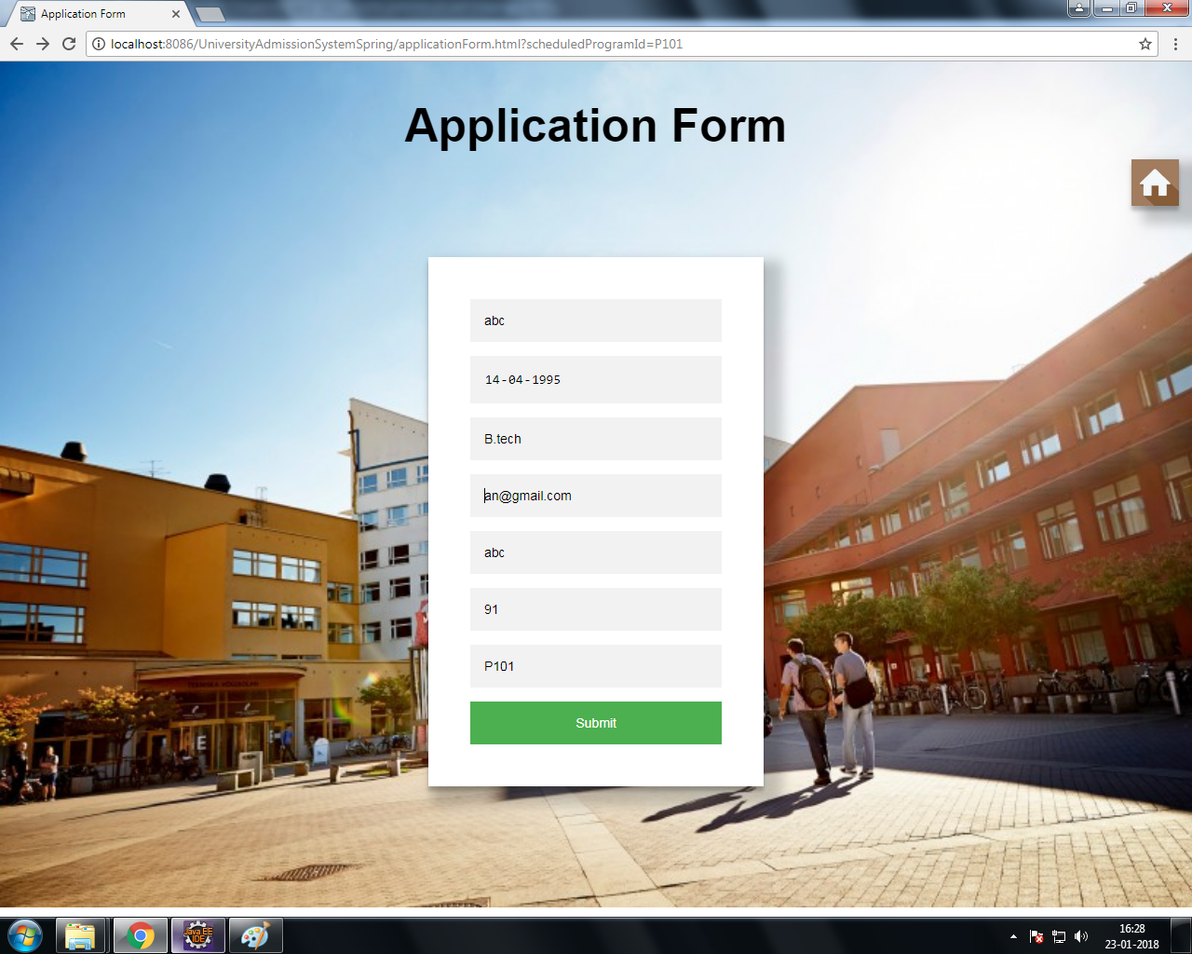
Apply for program
Apply online for a scheduled program of the university, by filling up the application form.

Slide 13
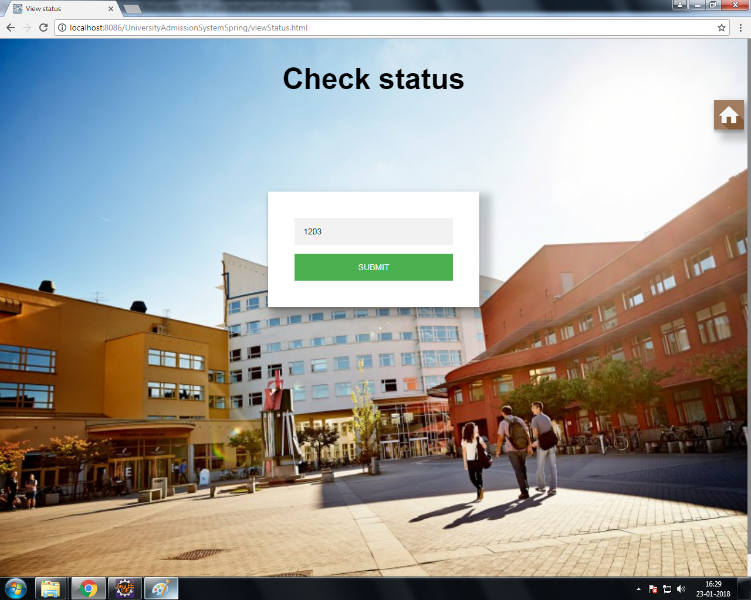
View status
View the application status, based on the application ID.

Slide 14
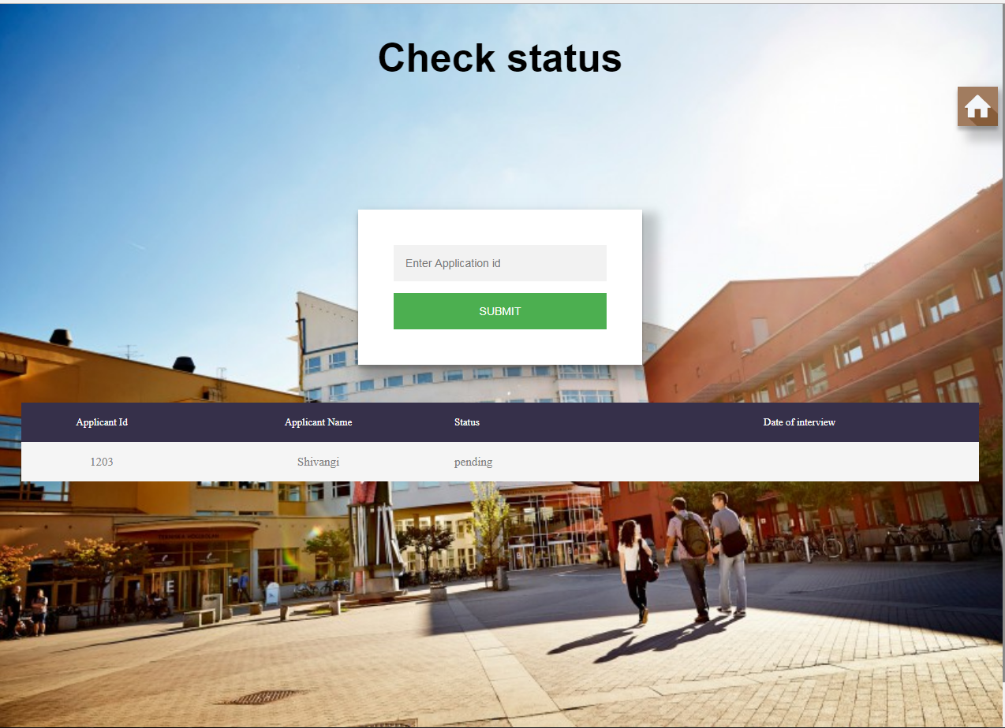

Slide 15
Login Module

Slide 16
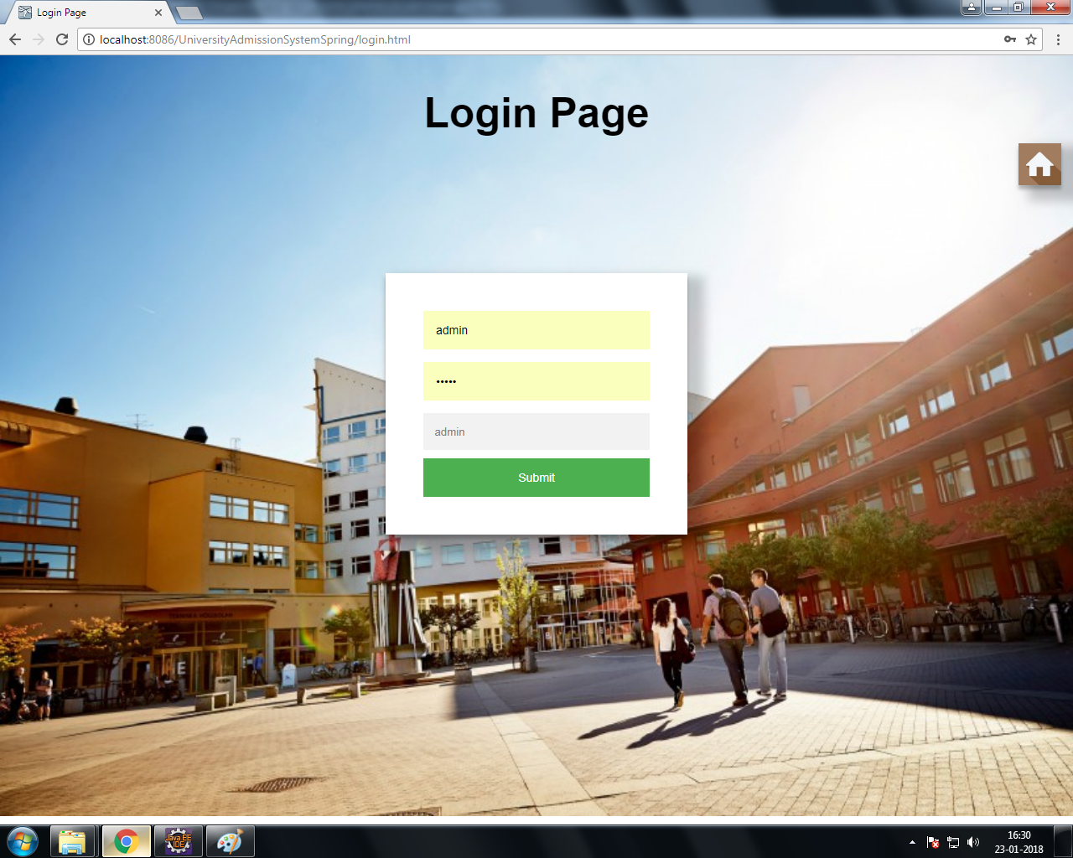
Login
Login into the system using his/her credentials.

Slide 17
Admin Module

Slide 18
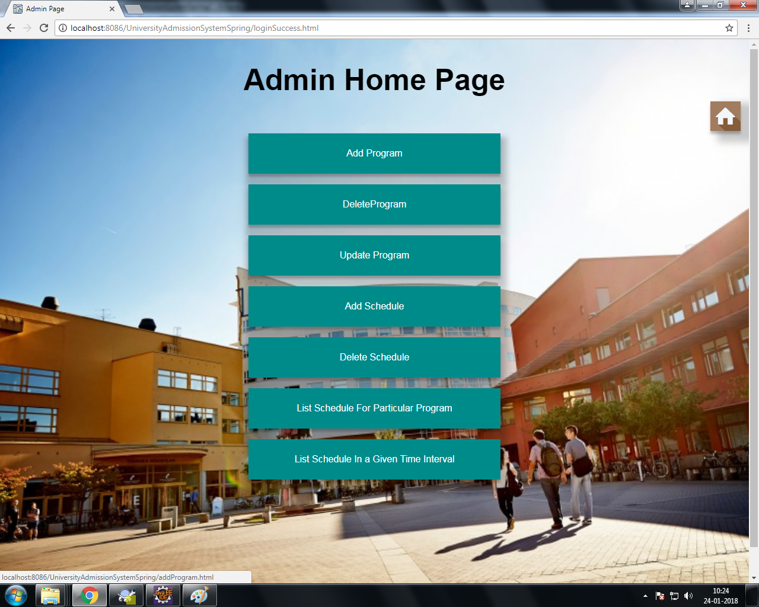
Admin Home Page

Slide 19
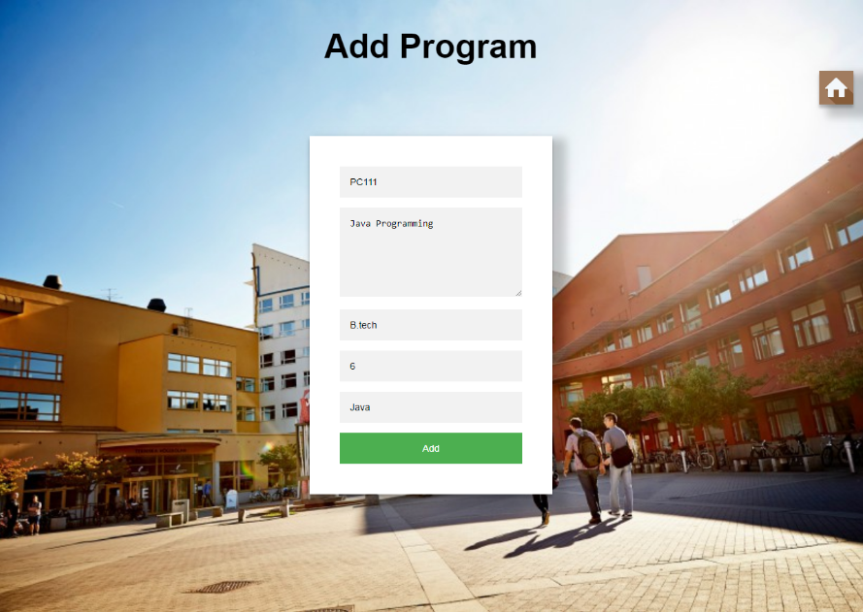
Add program
Add information of the programs offer by the university.

